Slide 1
Data Structures
Stacks : Applications
(Evaluation of Expressions)

Slide 2
Algebraic Expression
An algebraic expression is a legal combination of operands and the operators.
Operand is the quantity (unit of data) on which a mathematical operation is performed.
Operand may be a variable like x, y, z or a constant like 5, 4,0,9,1 etc.
Operator is a symbol which signifies a mathematical or logical operation between the operands. Example of familiar operators include +,-,*, /, ^
Considering these definitions of operands and operators now we can write an example of expression as x+y*z.

Slide 3
Infix, Postfix and Prefix Expressions
INFIX: Normal way of expressing the expressions in which operands surround the operator.
e.g. x+y, 6*3
PREFIX: Prefix notation also Known as Polish notation. In the prefix notation, as the name only suggests, operator comes before the operands.
e.g. +xy, *+xyz etc.
POSTFIX: Postfix notation are also Known as Reverse Polish Notation (RPN). They are different from the infix and prefix notations in the sense that in the postfix notation, operator comes after the operands.
e.g. xy+, xyz+* etc.

Slide 4
Ways of Representing Expressions
Notation | Arithmetic Expression
 | Representation | Short Form | Eg.
Infix | Left Operand Operator Right Operand | LOR | A+B
Prefix | Operator Left Operand Right Operand | OLR | +AB
PostFix | Left Operand Right Operand Operator | LRO | AB+

Slide 5
Ex: 3 + 5 – 4
+ and – have same precedence => (3 + 5) – 4
Ex: 3 ۸ 5 ۸ 2 => 3 ۸ (5 ۸ 2 )
Example of infix to postfix conversion :
(A + B) * (C – D) ۸ E * F
Step :1 (AB+) * (CD-) ۸ E * F
Step :2 Evaluate (CD-) ۸ E first

Slide 6
Step :3 CD-E ۸
Now the expression is (AB+) * CD - E ۸ * F
Now evaluate the expression from left to right, since both ‘*’ have same precedence.
Step :4 AB + CD - E ۸ * F *
The required postfix expression.

Slide 7
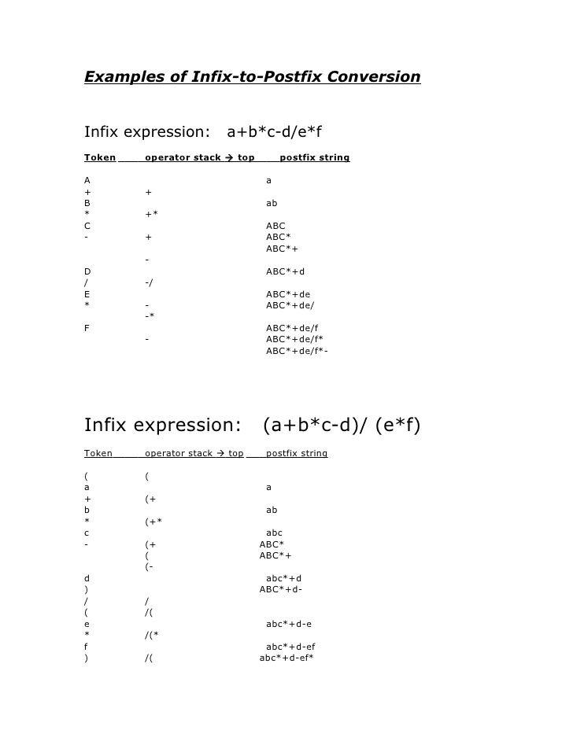

Slide 8
Example of infix to prefix conversion:
A +(((B-C)*(D-E)+F)/G) ۸H
Evaluate the expression within parenthesis
A +(((-BC)*(-DE)+F)/G) ۸H
Evaluate the expression left to right
A+((*-BC-DE+F)/G) ۸H
A+((+*-BC-DEF)/G) ۸H

Slide 9
A+(/+*-BC-DEFG) ۸H
۸ has more precedence than +
A+ ۸/+*-BC-DEFGH
+A ۸/+*-BC-DEFGH
This is the required prefix expression

Slide 10
Examples of Prefix Expressions
Infix
A+B
A+B-C
(A+B)*(C-D)
AɅB*C-D+E/F/(G+H)
((A+B)*C-(D-E)) Ʌ(F+G)
A-B/(C*DɅE)
Prefix
+AB
-+ABC
*+AB-CD
+-*ɅABCD//EF+GH
Ʌ-*+ABC-DE+FG
-AB/*CɅDE

Slide 11
Examples of Postfix Expressions
Infix
A+B
A+B-C
(A+B)*(C-D)
AɅB*C-D+E/F/(G+H)
((A+B)*C-(D-E)) Ʌ(F+G)
A-B/(C*DɅE)
Postfix
AB+
AB+C-
AB+CD-*
AbɅC*D-EF/GH+/+
AB+C*DE--FG+Ʌ
ABCDEɅ*/-

Slide 12
Examples of infix to prefix and post fix
Infix | PostFix | Prefix
A+B | AB+ | +AB
(A+B) * (C + D) | AB+CD+* | *+AB+CD
A-B/(C*D^E) | ABCDE^*/- | -A/B*C^DE

Slide 13
Consider an infix expression- Postfix
Scan from left to right
(A-(B+C))*D
Symbol | Postfix string | Operand stack
( |  | (
A | A | (
- | A | (-
( | A | (-(
B | AB | (-(
+ | AB | (-(+
C | ABC | (-(+

Slide 14
) | ABC+ | (-
) | ABC+-
* | ABC+- | *
D | AC+-D | *
) | ABC+-D* | *

Slide 15
Consider an infix expression – Prefix
Scan from right to left-
(a+b*c/d+(c+d))
Symbol | Postfix string | Operand stack
 |  | )
) |  | ))
d | d | ))
+ | d | ))+
c | dc | ))+
( | dc+ | )
+ | dc+ | )+
d | dc+d | )+

Slide 16
/ | dc+d | )+/
c | dc+dc | )+/
* | dc+dc | )+/*
b | dc+dcb | )+/*
+ | dc+dcb* | )+/
 | dc+dcb*/ | )+
 | dc+dcb*/ | )++
a | dc+dcb*/a | )++
( | dc+dcb*/a++ | )

Slide 17
Algorithm for Infix to Postfix
1) Examine the next element in the input.
2) If it is operand, output it.
3) If it is opening parenthesis, push it on stack.
4) If it is an operator, then
  i) If stack is empty or top of stack is opening parenthesis, push operator on stack.
  ii) If it has higher priority than the top of stack, push operator on stack.
  iv) Else pop the operator from the stack and output it, repeat step 4
5) If it is a closing parenthesis, pop operators from stack and output them until an opening parenthesis is encountered. pop and discard the opening parenthesis.
6) If there is more input go to step 1
7) If there is no more input, pop the remaining operators to output.

Slide 18

Infix to postfix conversion
infixVect
( a + b - c ) * d – ( e + f )
postfixVect

Slide 19
Infix to postfix conversion
stackVect
infixVect
a + b - c ) * d – ( e + f )
postfixVect
(

Slide 20
Infix to postfix conversion
stackVect
infixVect
+ b - c ) * d – ( e + f )
postfixVect
a
(

Slide 21
Infix to postfix conversion
stackVect
infixVect
b - c ) * d – ( e + f )
postfixVect
a
+
(

Slide 22
Infix to postfix conversion
stackVect
infixVect
- c ) * d – ( e + f )
postfixVect
a b
+
(

Slide 23
Infix to postfix conversion
stackVect
infixVect
c ) * d – ( e + f )
postfixVect
a b +
-
(

Slide 24
Infix to postfix conversion
stackVect
infixVect
) * d – ( e + f )
postfixVect
a b + c
-
(

Slide 25
Infix to postfix conversion
stackVect
infixVect
* d – ( e + f )
postfixVect
a b + c -

Slide 26
Infix to postfix conversion
stackVect
infixVect
d – ( e + f )
postfixVect
a b + c -
*

Slide 27
Infix to postfix conversion
stackVect
infixVect
– ( e + f )
postfixVect
a b + c - d
*

Slide 28
Infix to postfix conversion
stackVect
infixVect
( e + f )
postfixVect
a b + c – d *
-

Slide 29
Infix to postfix conversion
stackVect
infixVect
e + f )
postfixVect
a b + c – d *
(
-

Slide 30
Infix to postfix conversion
stackVect
infixVect
+ f )
postfixVect
a b + c – d * e
(
-

Slide 31
Infix to postfix conversion
stackVect
infixVect
f )
postfixVect
a b + c – d * e
+
(
-

Slide 32
Infix to postfix conversion
stackVect
infixVect
)
postfixVect
a b + c – d * e f
+
(
-

Slide 33
Infix to postfix conversion
stackVect
infixVect
postfixVect
a b + c – d * e f +
-

Slide 34
Infix to postfix conversion
stackVect
infixVect
postfixVect
a b + c – d * e f + -

Slide 35
gets(infix)
for(i=0;infix[i]!=‘\0’;i++)
{
If(isalpha(infix[i]))
{
post[j]=infix[i];
j++;
}else
{
switch(infix[i])
{
case ‘(‘:
push(‘(‘);
beak;
case ‘)’:
while(stack[top]!=‘(‘)
{

Slide 36
post[j]=pop();
j++;
}
pop();
break;
default:
while(prec(infix[i]<=prec(stack[top]))
{
post[j]=pop();
j++;
}
push(infix[i]);
break;
}
}
}
post[j]=‘\0’;
puts(post);

Slide 37
int prec(char ch)
{
switch(ch)
{
case ‘(‘: return(0); break;
case ‘+’:
case ‘-’: return(1); break;
case ‘*’:
case ‘/’: return(2); break;
case ‘^’: return(3);break;
}
}
void push(char ch)
{
top++;
stack[top]=ch;
}

Slide 38
Evaluating a postfix expression
Initialise an empty stack
While token remain in the input stream
  Read next token
  If token is a number, push it into the stack
  Else, if token is an operator, pop top two tokens off the stack, apply the operator, and push the answer back into the stack
Pop the final token(answer) off the stack.

Slide 39
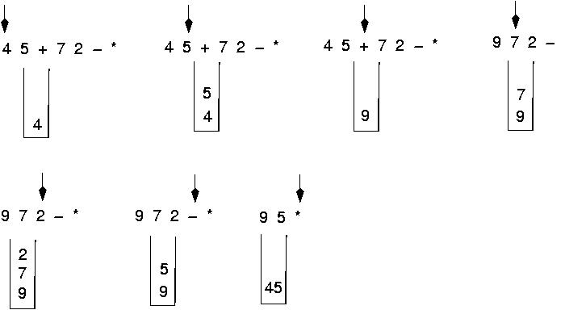
Postfix expressions:
Algorithm using stacks (cont.)

Slide 40
Thank You

